Slide 1






Terrorism responses at
large events
A Victim Centered Approach

Slide 2
These are our cities and our communities. When planning for major events, we must recognise that if we only start thinking about victims after something has happened, it is already too late. A victim-centred approach must be embedded from the very first stage of preparation, including asking a simple but crucial question: what will it look like to take care of the people affected? When this perspective is integrated into real-world exercises and operational command, it can transform how institutions think and ensure that the needs of victims are an integral part of the response.
Sheriff Kevin McMahill,
Las Vegas PD

Slide 3
Terrorism responses at
large events
A Victim Centered Approach

Slide 4



Who is Victim Support Europe?
Victim Support Europe (VSE) is the leading European umbrella organisation advocating on behalf of all victims of crime, no matter what the crime, no matter who the victim is.
Founded in 1990
Network of +/- 80 organisations: NGOs, State, Individuals, Universities in 33 Countries
5000+ staff and volunteers
3 million+ victims supported by members per year
Carries out: advocacy, policy development, capacity building, training in Europe and globally
EU Centre of Expertise for victims of terrorism

Slide 5
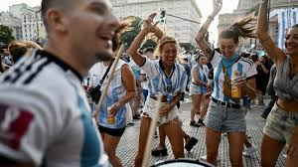
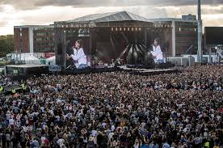
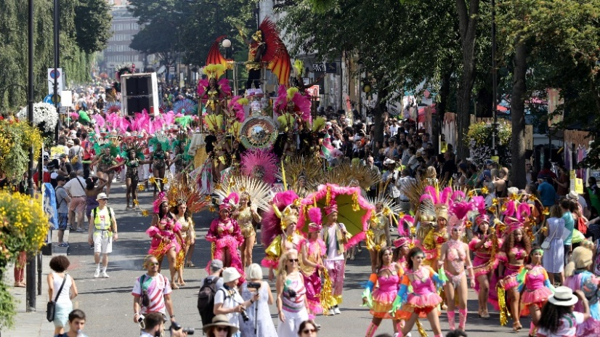
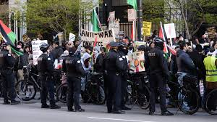
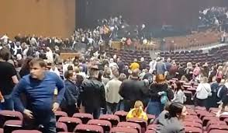
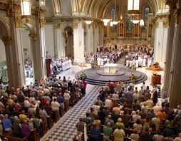
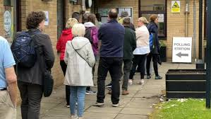





What is a large scale event
A specifically identifiable, pre-organized event
Number of participants not specified
Open vs closed
Registered vs unregistered
Large vs superlarge
Nature of activity
Location of activity

Slide 6

Why focus on large scale events
heightened risk, scale of impact, upcoming events – Fifa, elections, protests, concerts
Current failure to incorporate victim expertise, entire community
Public demands and appreciates enhanced safety as part of experience
Clear event to prepare for – opportunities to enhance our response
Identifiable community to work with
INVICTM Policy Paper – High level approaches and recommendations

Slide 7
FOUNDATION FOR ALL
SPECIALISATION LAYERED ON TOP

Slide 8
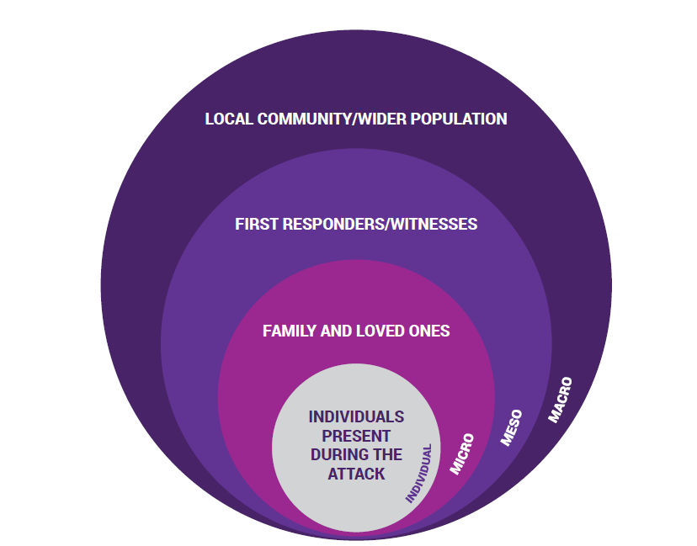
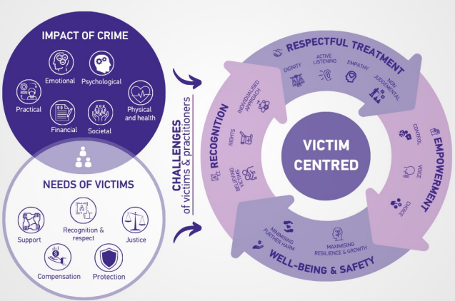
A victim centric approach
WHO SHOULD WE HELP? WHAT SHOULD WE KNOW HOW SHOULD SOLUTIONS BE DESIGNED
Interactions should be based on:
Respect – Dignity, active listening, empathy, non-judgemental
Empowerment – Control, voice, choice
Wellbeing and Safety – Minimise further harm, maximise resilience and growth
Recognition – Believed, rights in reality, individualised approach

Slide 9

VICTIM SENSITIVE:
A holistic, systematic, needs-driven, rights-based approach which ensures the physical, psychological, and emotional safety of the victim and respect for the victims dignity, minimising further harm whilst maximising recovery

Slide 10
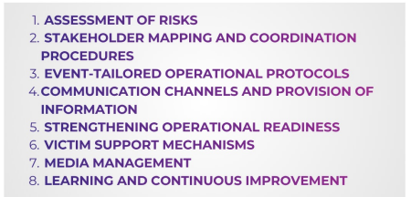


Key Findings

Slide 11
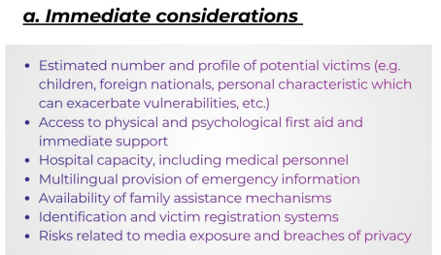
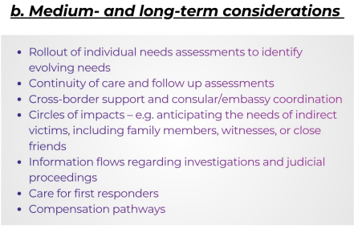
Risk assessment
Planning should anticipate the human impact of incidents, not only the threat itself.
Preparedness must account for resources needed to support victims and communities

Slide 12
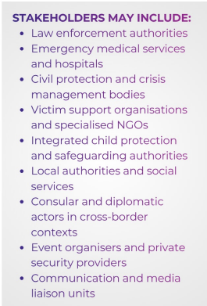
Mapping of audience/ Stakeholders
comprehensive mapping of all actors who may play a
role at any stage of emergency response.
Structured events: ID audience and those present (staff, volunteer)
ID specific needs/ categories – adapt preparedness
Establish victim identification protocols, technology, partnerships

Slide 13
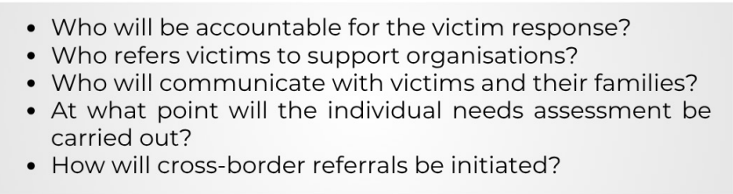
How to collaborate

Slide 14
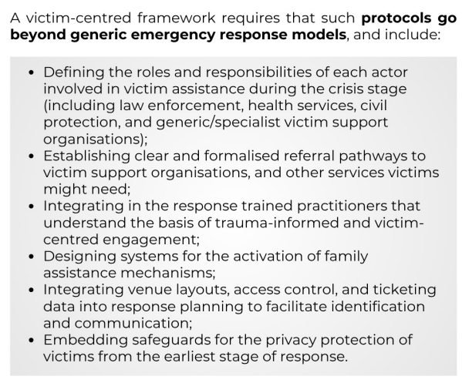
Operational Protocols
Adapted to each type of event: distinct infrastructural configurations, governance arrangements, audience demographics, or risk exposures

Slide 15
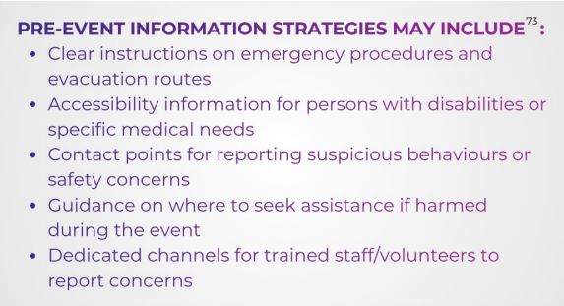
Communication channels – pre-crisis
structured provision of pre-event information to participants, staff, volunteers, and other accredited persons.
- reassures attendees,
- Strengthens individual preparedness,
- minimises panic (non-alarmist)
- Increases support seeking behaviours
"information is therefore not merely
a service feature;
it is a protective andrights-enabling tool"

Slide 16
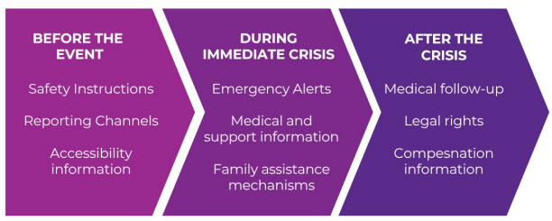
Communication channels – Acute phase
- Information provision should be timely, accurate, and tailored to the needs of different groups
- Clarity and accessibility - messages should be concise and using plain language. Visual aids, infographics etc
- Multilingual
- Delivery through multiple channels - e.g., crisis helplines, local radio, SMS alerts, public announcements, or apps etc
- What information should be included e.g. medical assistance, access specialised support services, family assistance procedures, psychological first aid, legal rights, or compensation schemes,

Slide 17
Seven phases for Communication/ prevention
Ticket sales - Pre-Event phase = potential to influence the behaviour/expectations of people. Use of colour coding/numerical coding. Understand & analyse your audience
Arrival Phase = arrive in a city/location. Opportunity to secure event & help your audience: clear signings, well-lit security patrols, volunteers, etc.; information panels, etc.
Last Mile/Grey Space/Zone X Phase = number one security concern (thefts, assaults, etc.). Great opportunity for psychological security. Important to establish who owns that location.
Ingress Phase = robust security to detect
Circulation Phase = key things on ground- locations with multiple language speakers to look after guests (app, water, locations to get advice, meeting points, etc.)
Egress Phase
Dispersal Phase = security & safety concerns until the grey area

Slide 18
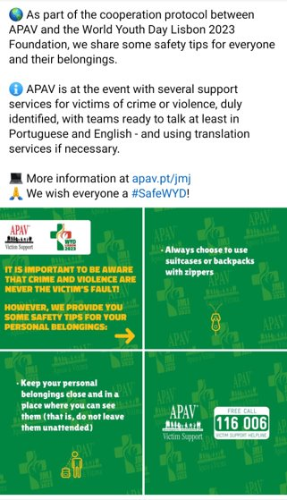
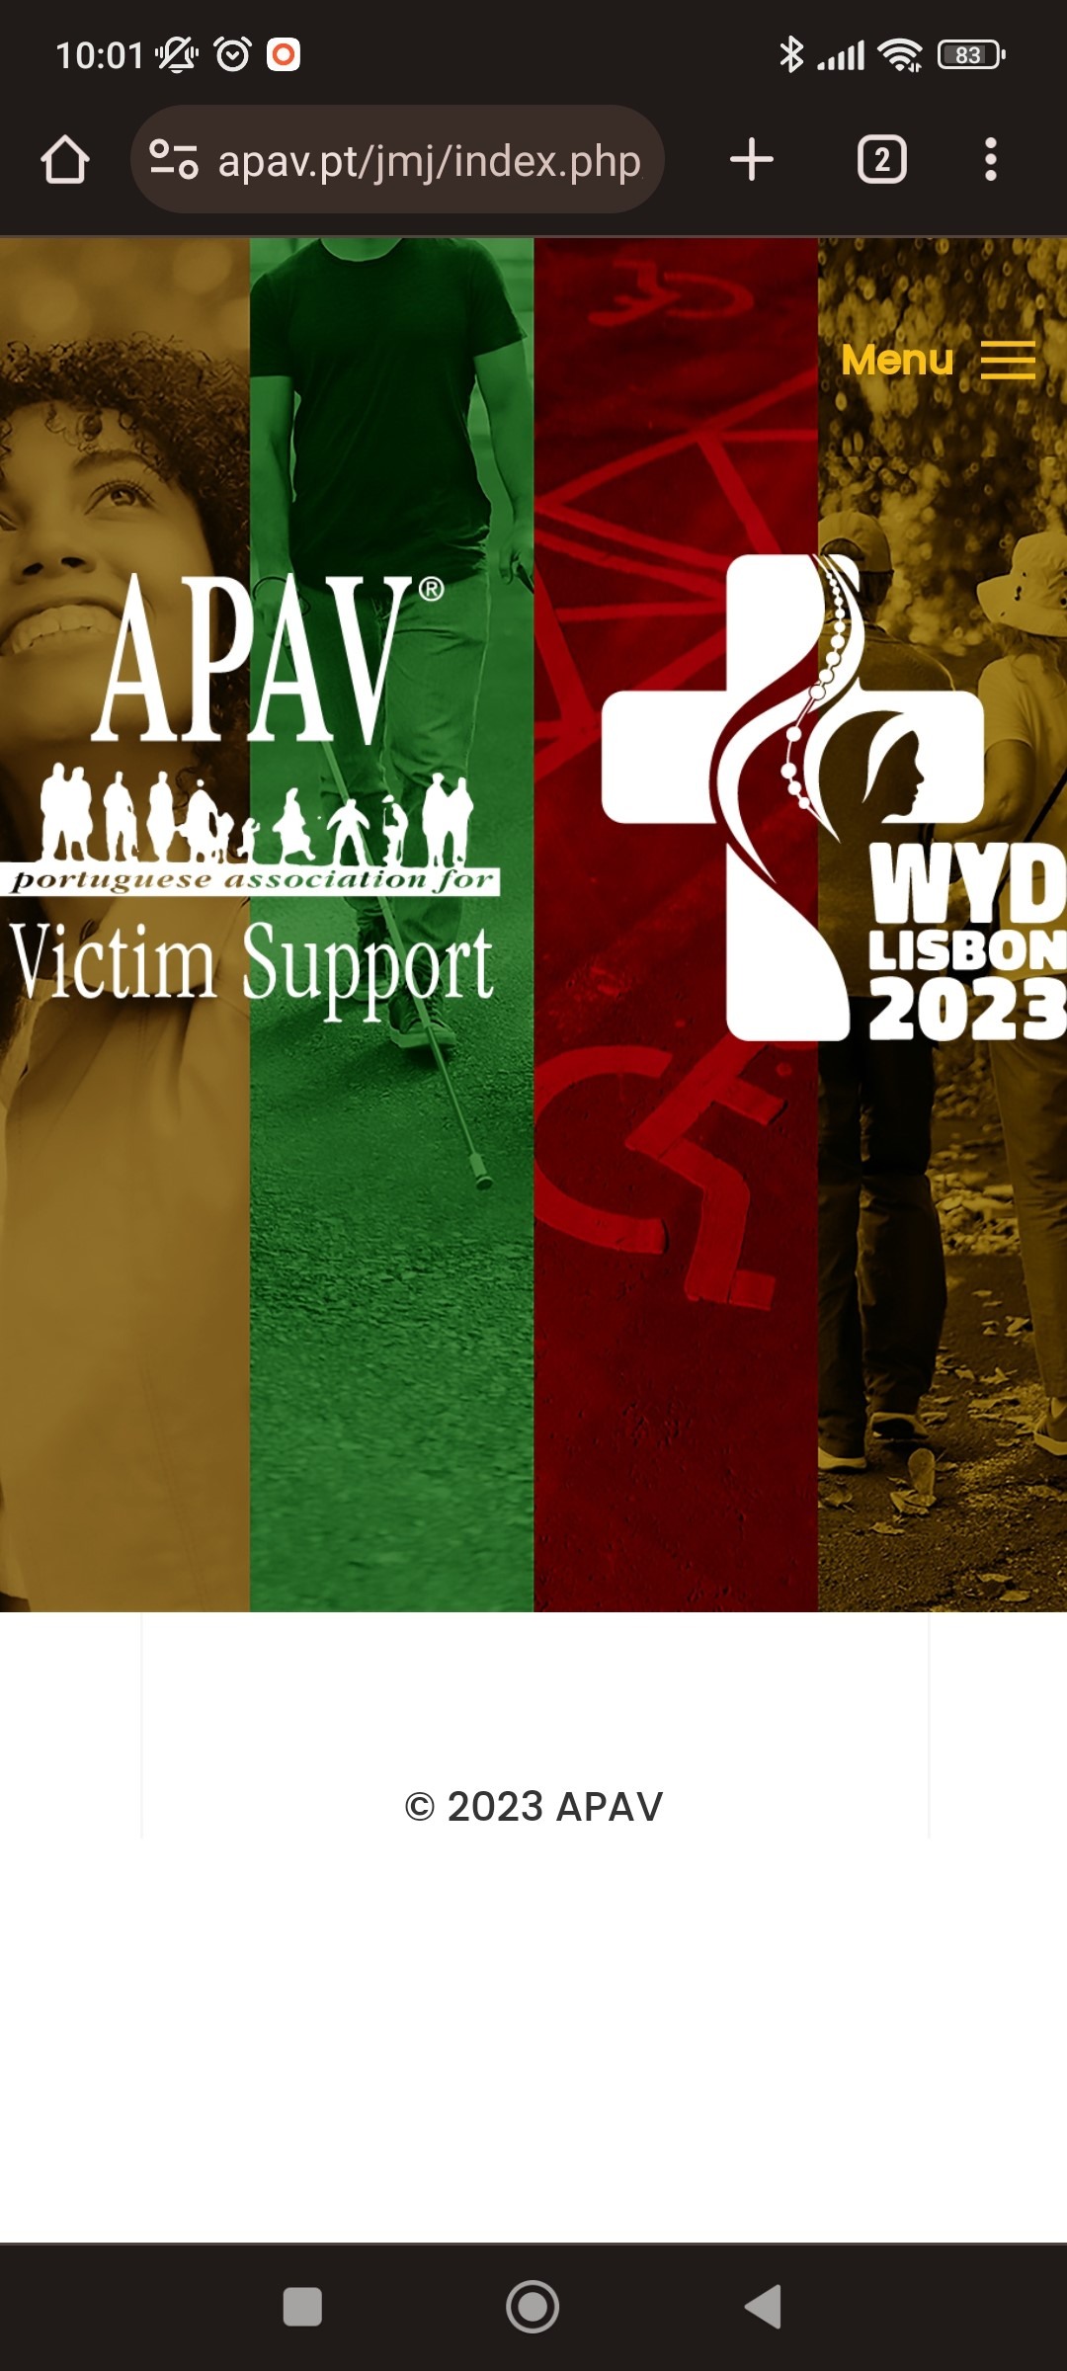


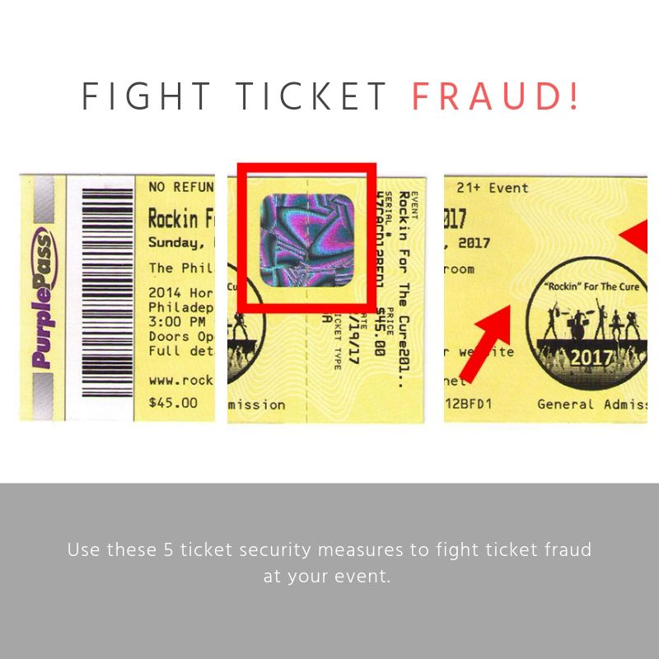
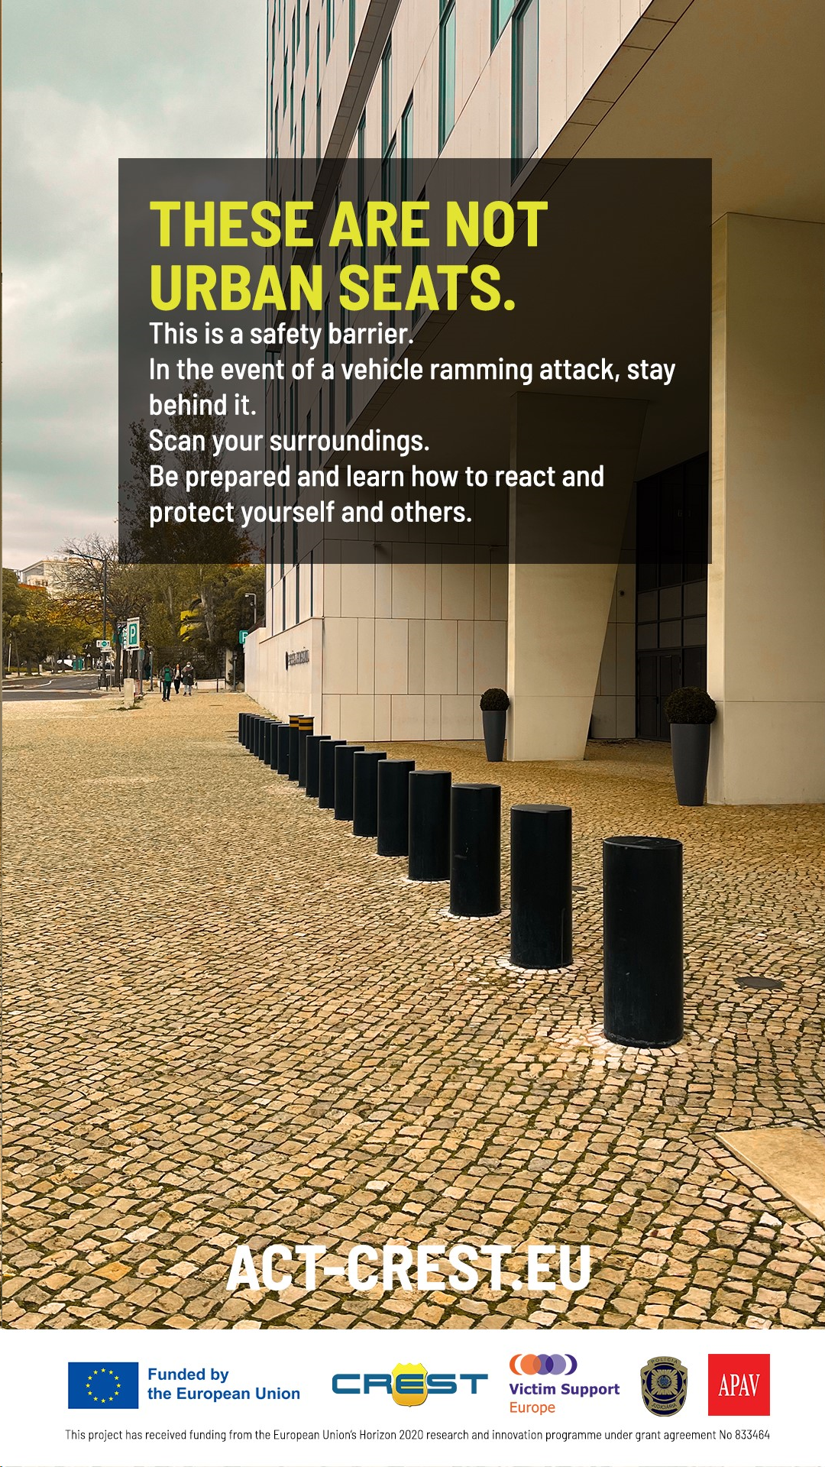
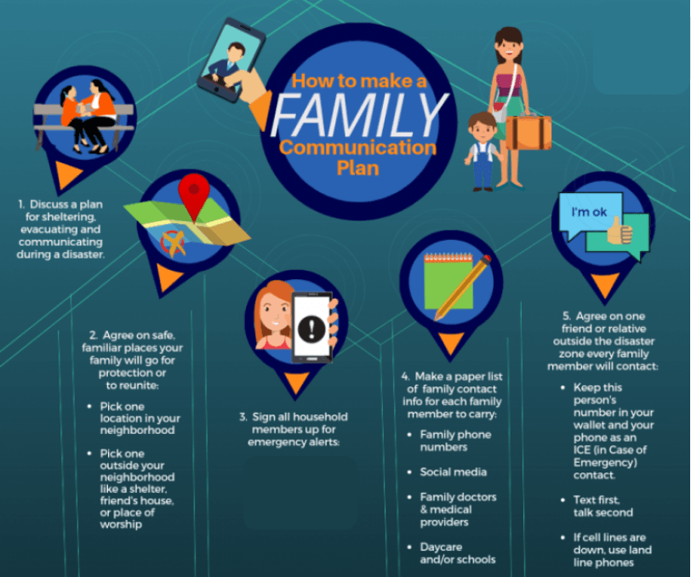
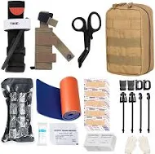
Pre/during-event Comms and Actions
PREVENT
TICKETING
COME PREPARED
SURVIVE

Slide 19
Strengthen operational readiness
- Test victim-centred protocols through realistic exercises.
Include victim support organisations in planning and operational exercises.
Ensure responders are trained and equipped to provide immediate life-saving support.

Slide 20
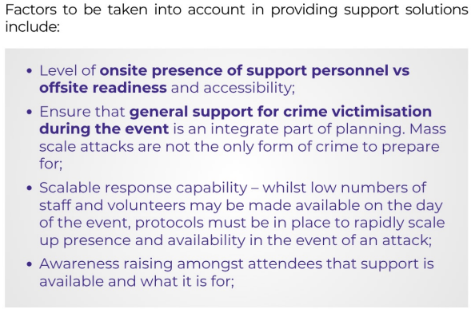
Support Services

Slide 21
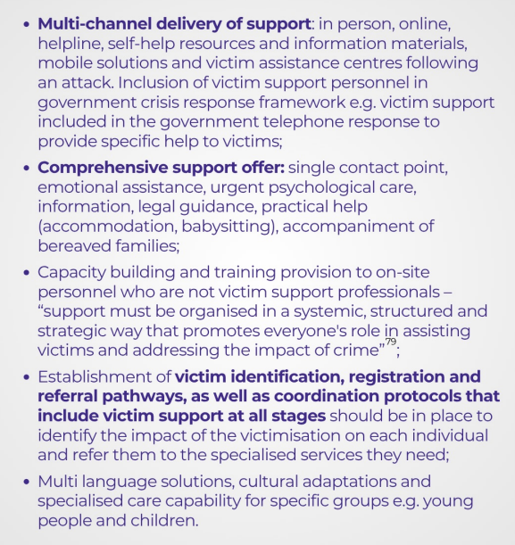
Support Services

Slide 22
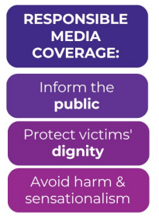
Media Management

Slide 23
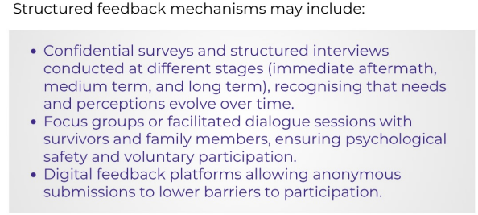
Continuous Improvement

Slide 24
THANK YOU!
LEVENT ALTAN
Executive Director
l.altan@victimsupporteurope.eu​
​
www.victim-support.eu​
info@victimsupporteurope.eu​

